Slide 1
E-book app
C#
Members:
Nguyễn Xuân Huy (Leader)
Trần Việt Hoàng
Trần Tuấn Hưng

Slide 2
CONTENTS
Introduction
Methods
Demo

Slide 3
01
Introduction

Slide 4
IT frameworks
Using C# programming language (Winform)
MVC design pattern
Microsoft sql server
EntityFramework

Slide 5
02
Methods

Slide 6
GUI
Login
Signup
Admin Form
User From
User login
Sign up account
Data management
Listen to e-book, read book, search book

Slide 7
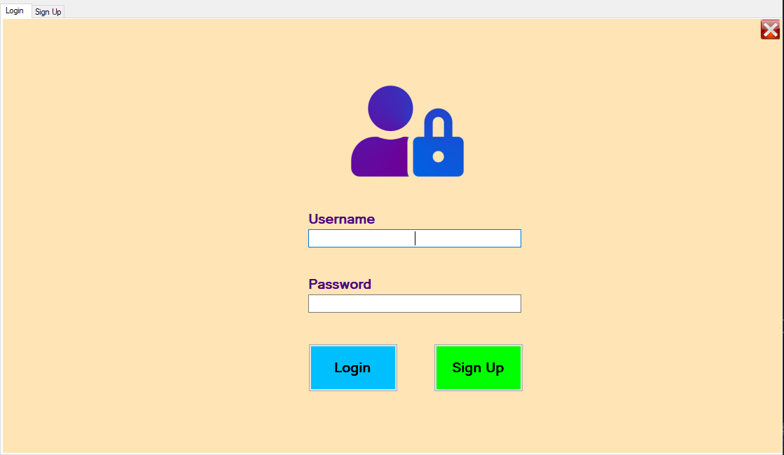
Login form

Slide 8
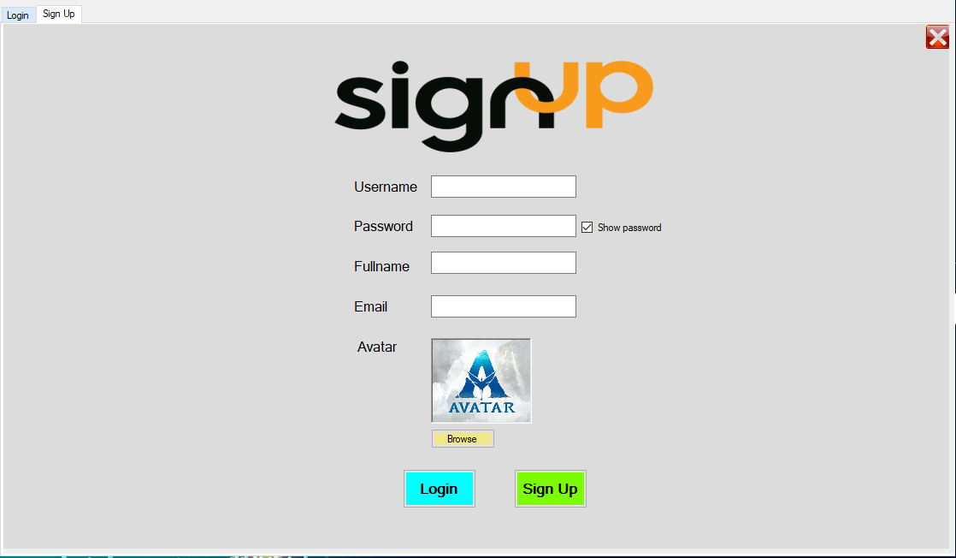
Sign up form

Slide 9
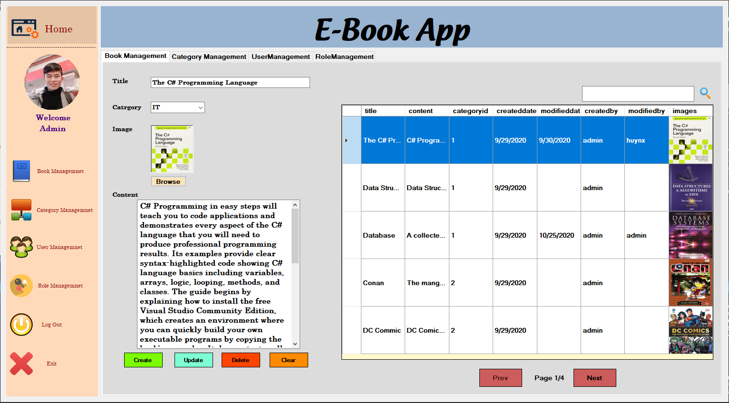
Admin form

Slide 10
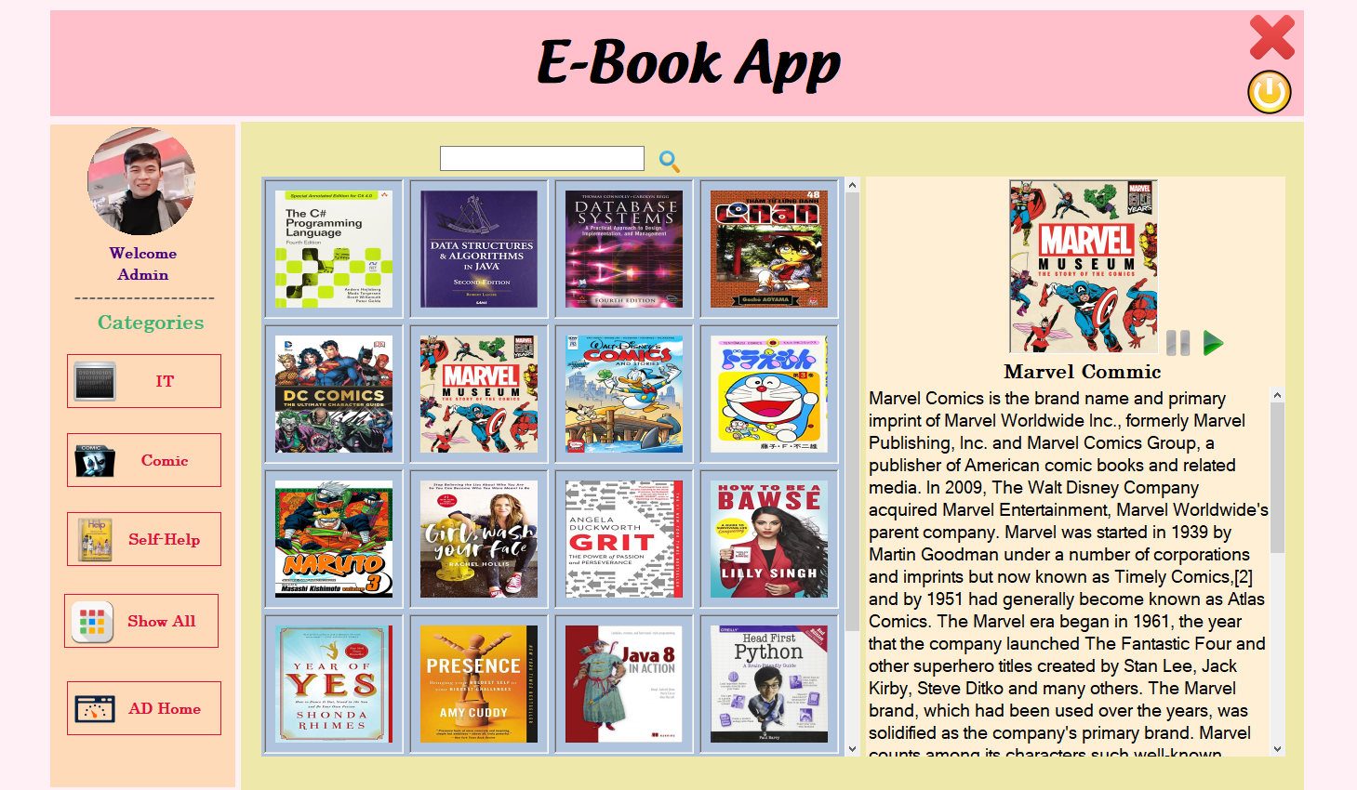
User form

Slide 11
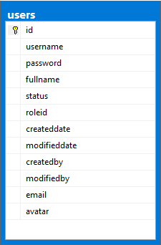

Users Tables DB

Slide 12
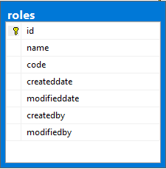
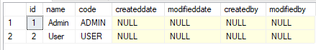
Roles Tables DB

Slide 13
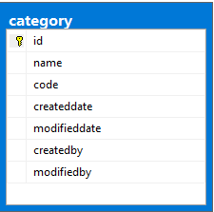
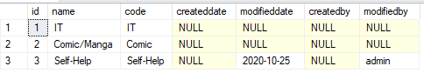
Category Tables DB

Slide 14
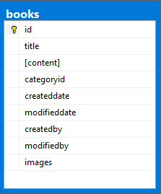
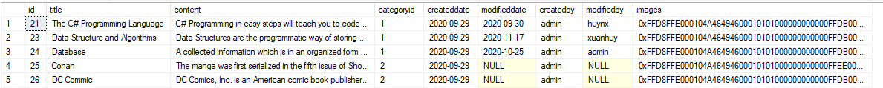
Books Tables DB

Slide 15
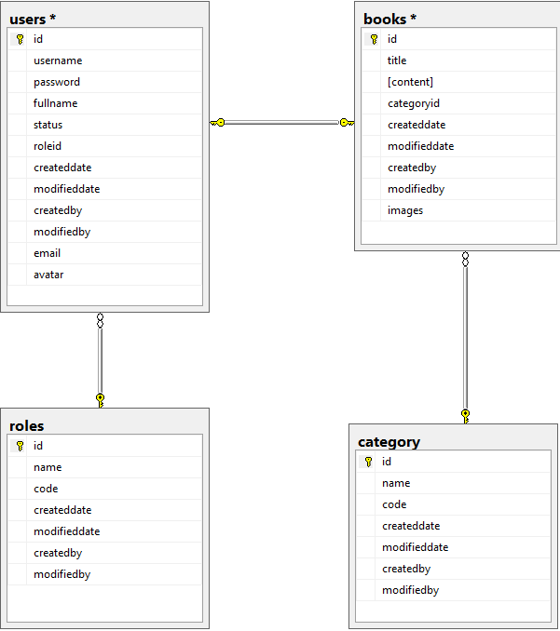
Database diagram

Slide 16
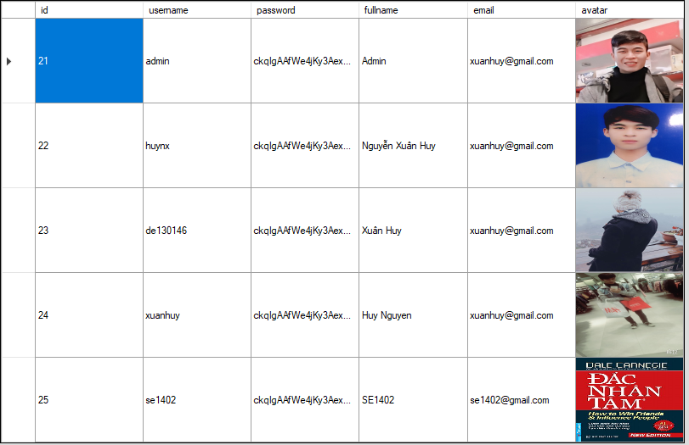
Security
Password Encryption using MD5

Slide 17
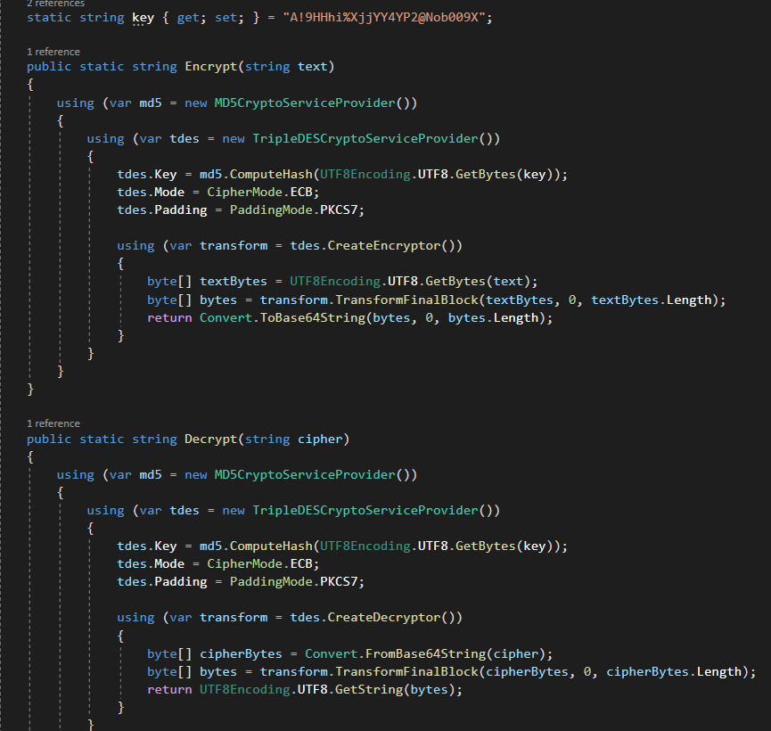

Slide 18
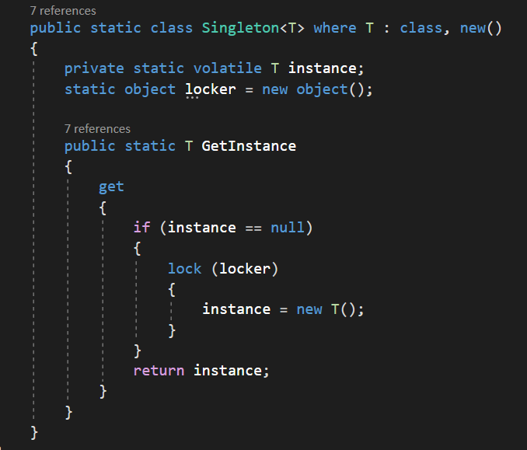
Singleton

Slide 19
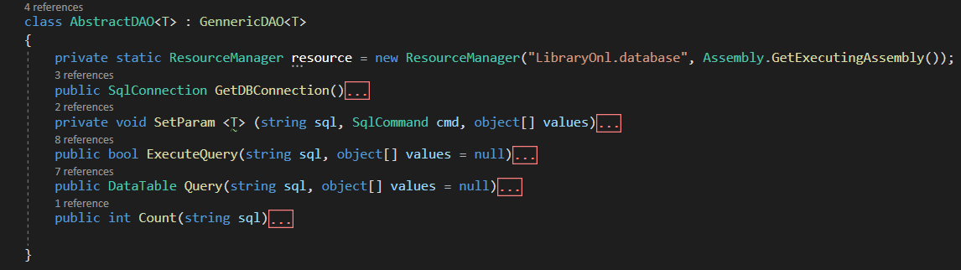
Core database

Slide 20
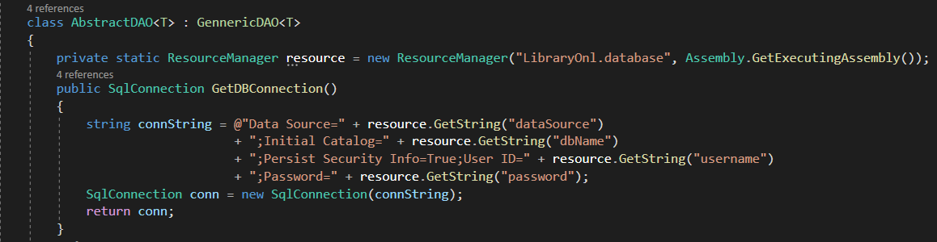
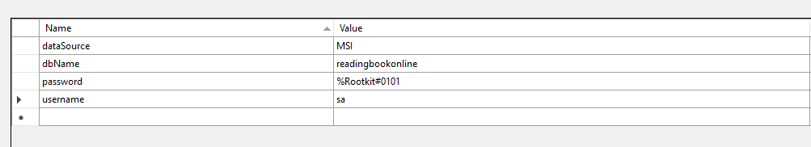

Slide 21
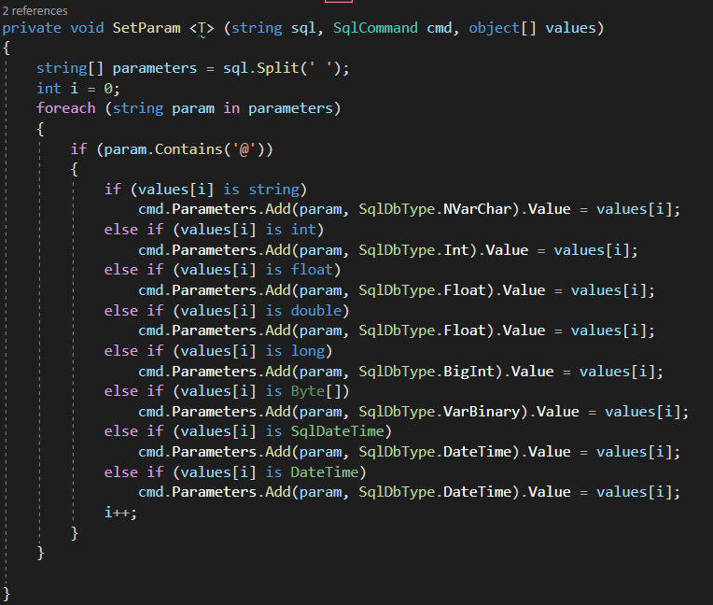

Slide 22
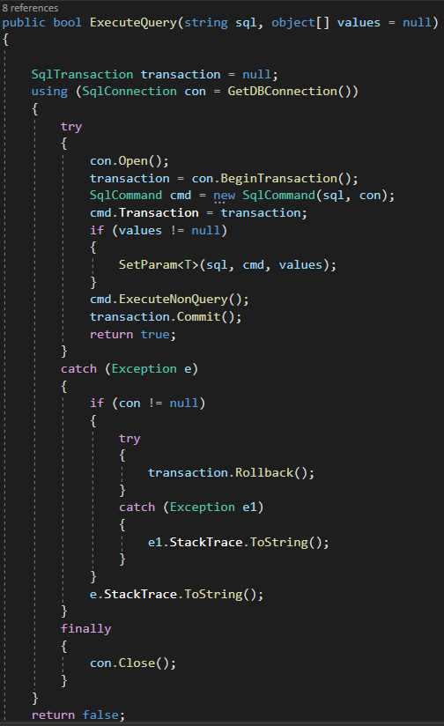
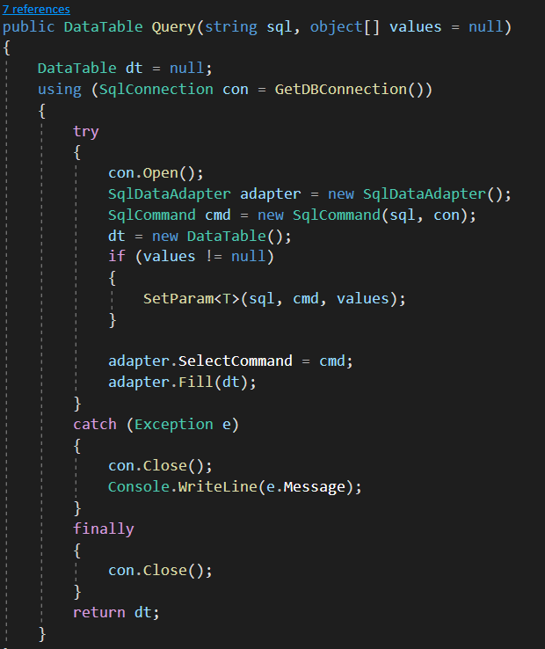

Slide 23
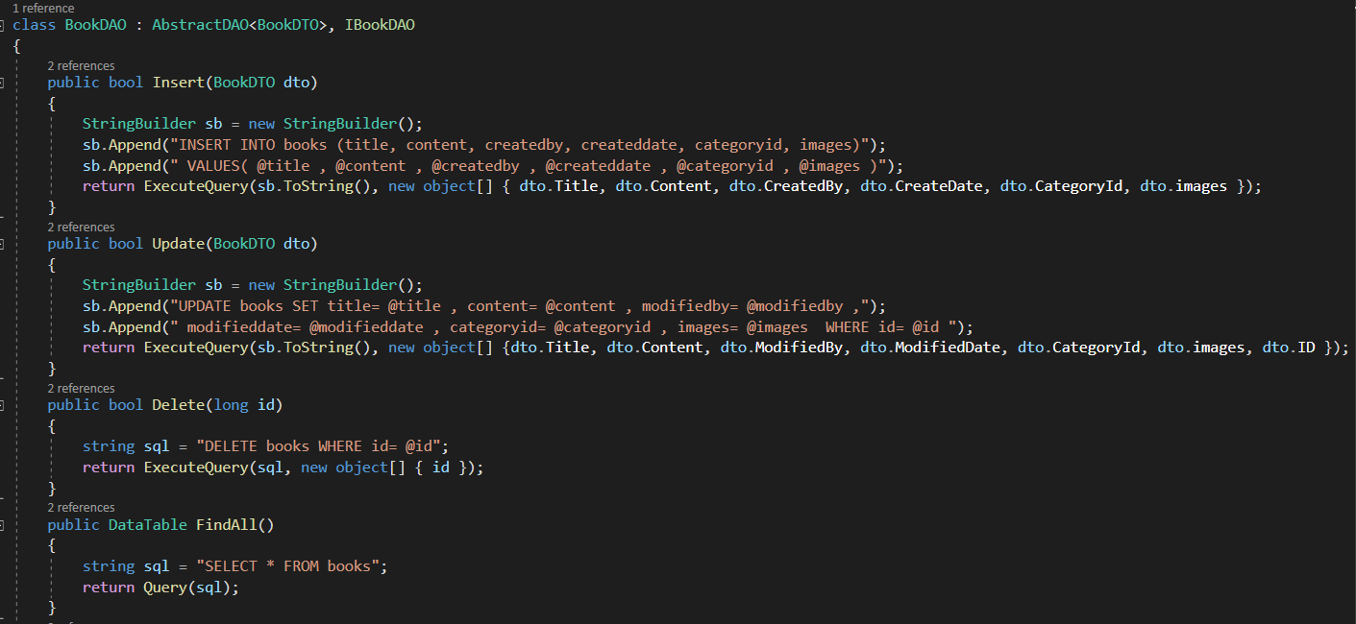

Slide 24
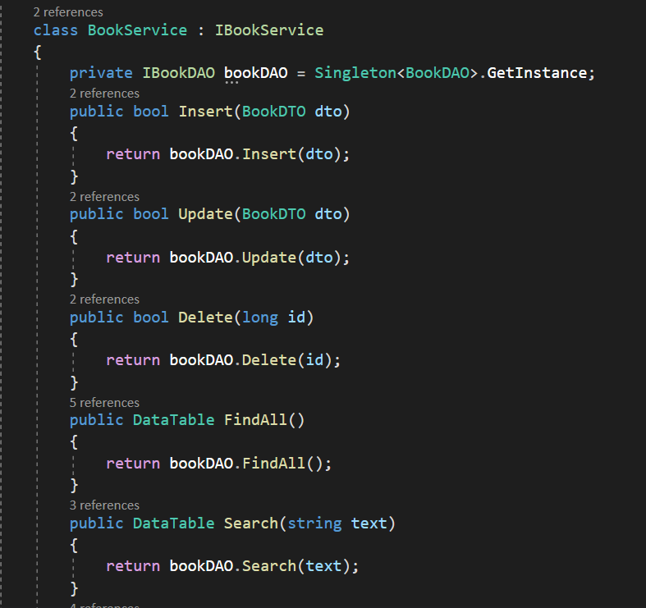

Slide 25
03
Demo

Slide 26

Thanks for your attention!
C#
SE1402

